Slide 1
Notes About Gradiometer
Mark Lindeman

Slide 2
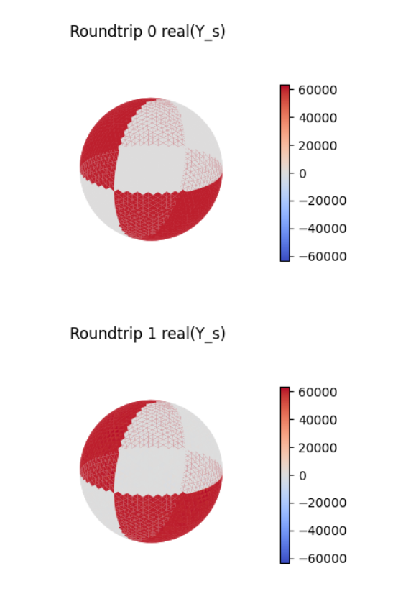
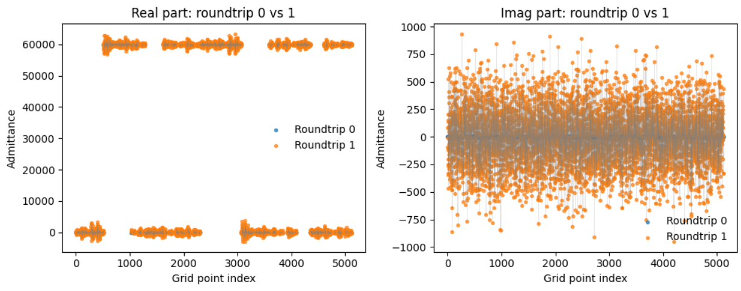

Slide 3
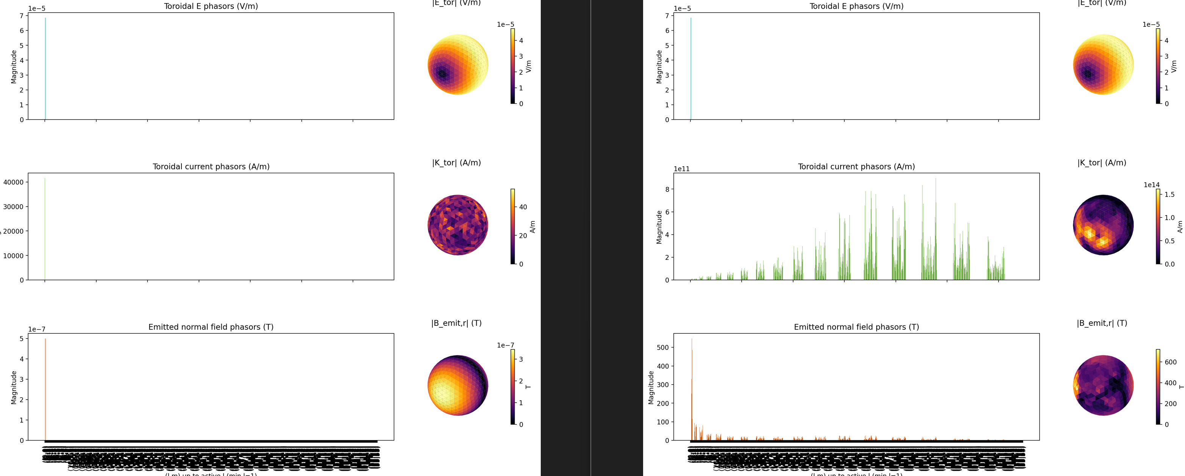
Issue with nonlinear solver, sd=3
For 3 subdiv. , current phasors does not match, nonlinear is DC only

Slide 4
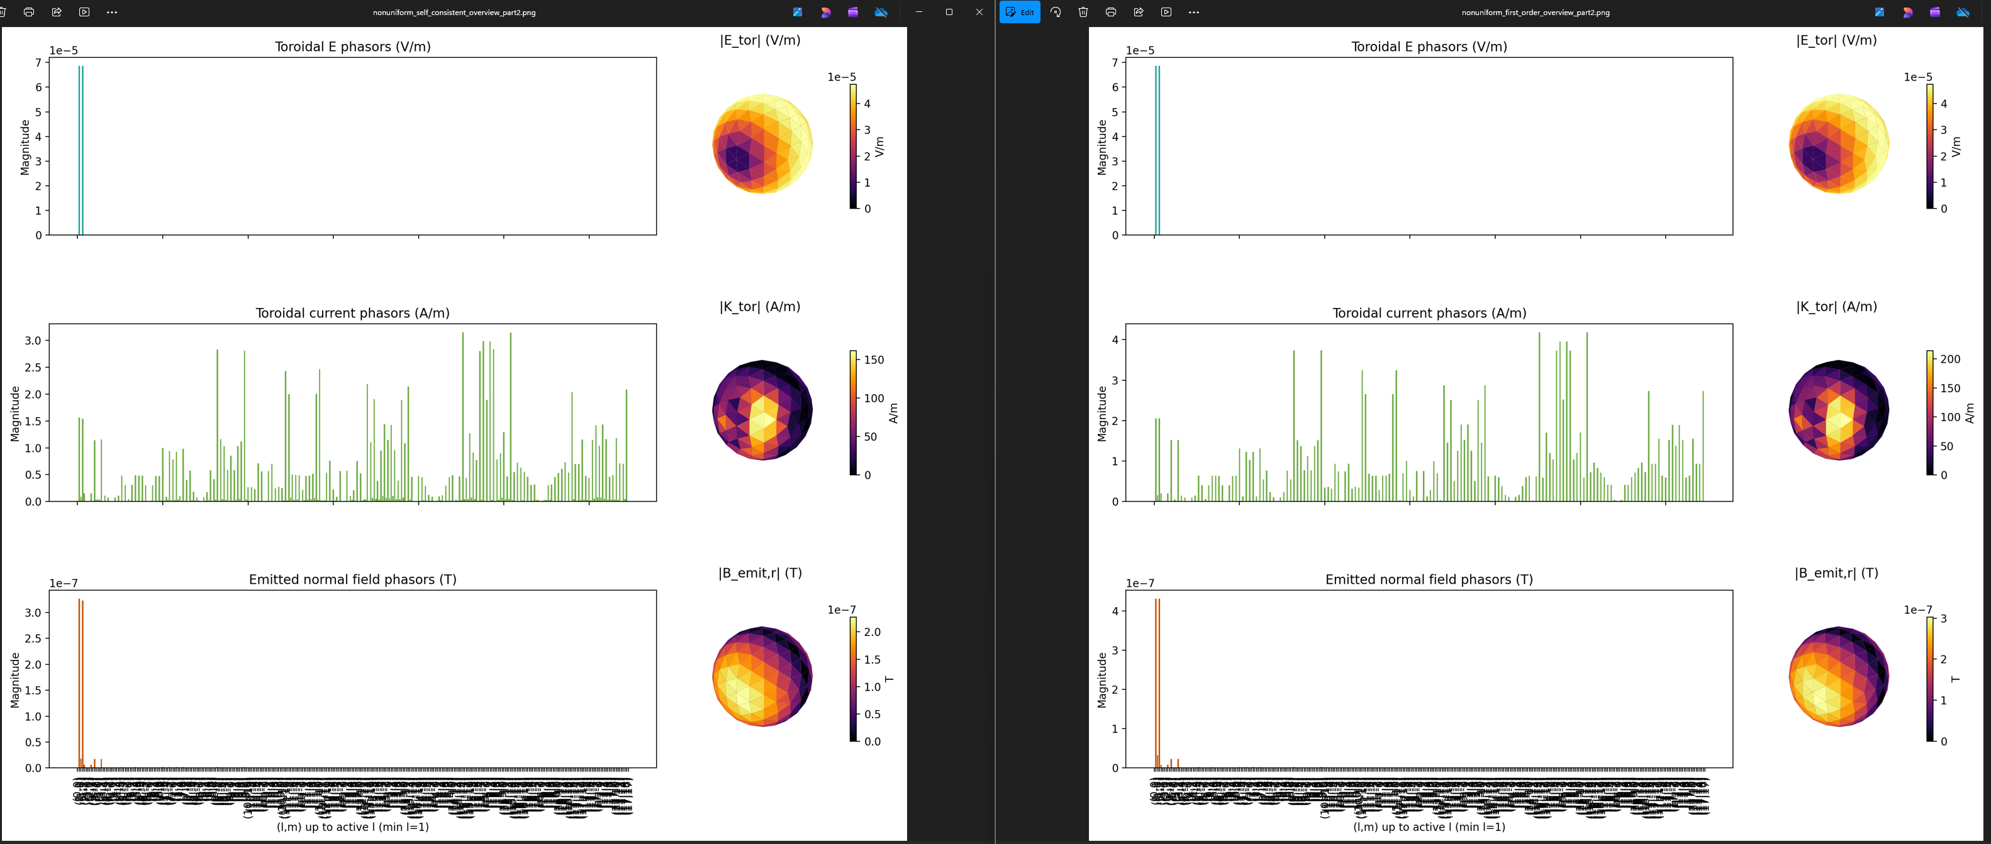
Non linear solver sd=2
Nonlinear closely matches linear for sd=2

Slide 5
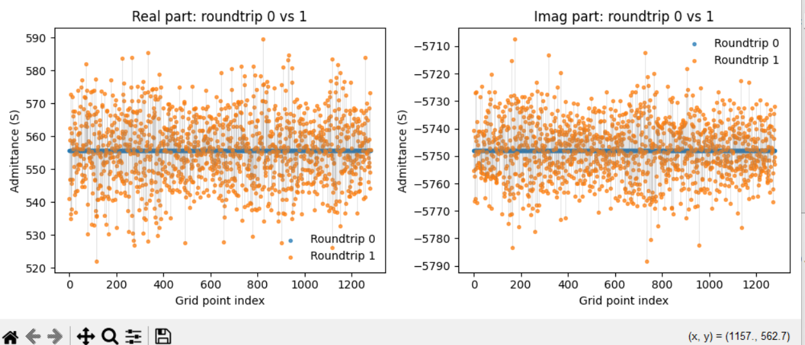
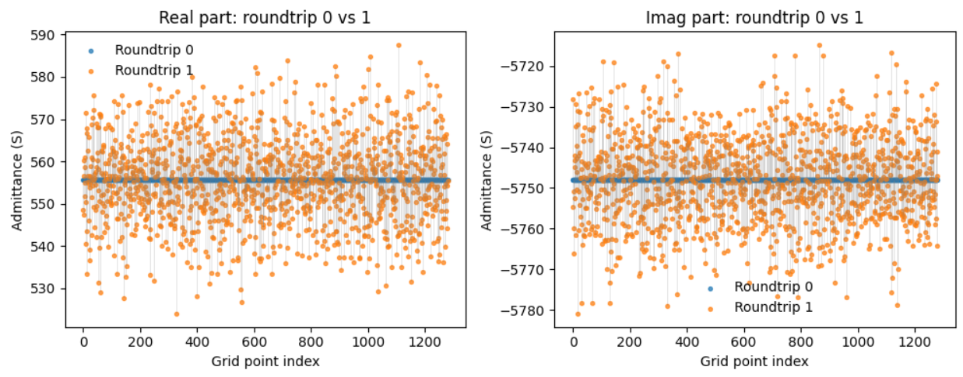
0.00001 % contrast -- unstable
Building sparse mixing matrix...
Solving first-order currents (no feedback)...
b_ext_flat: max|v|=5.000e-07, has_nan=False, has_inf=False
k_flat (first_order): max|v|=1.661e+03, has_nan=False, has_inf=False
K_tor (first_order): total power=1.161e+08, top l fractions: l=26:22.07%, l=28:20.31%, l=30:17.49%, l=24:12.37%, l=32:11.88%, l=22:5.43%
Error: First-order response energy exceeds source energy: resp=3.003e-12 > src=5.000e-13.
Step 1b complete. Displayed round-trip scatter plots.
Assembling Gaunt tensor from data\gaunt_cache_wigxjpf (lmax_limit=35)...
Gaunt tensor nnz=13813899, complete_L=35
Building sparse mixing matrix...
Solving first-order currents (no feedback)...
b_ext_flat: max|v|=5.000e-07, has_nan=False, has_inf=False
k_flat (first_order): max|v|=1.661e+03, has_nan=False, has_inf=False
K_tor (first_order): total power=1.161e+08, top l fractions: l=26:22.07%, l=28:20.31%, l=30:17.49%, l=24:12.37%, l=32:11.88%, l=22:5.43%
Error: First-order response energy exceeds source energy: resp=3.003e-12 > src=5.000e-13.
Cleared outputs in figures and artifacts\workflow.
Step 1 complete (subdivisions=3, faces=1280). Saved grid+admittance to artifacts\workflow\grid_admittance.pt
Step 1b complete. Displayed round-trip scatter plots.
Step 2 complete. Saved ambient + B_radial to artifacts\workflow\ambient.pt
Assembling Gaunt tensor from data\gaunt_cache_wigxjpf (lmax_limit=35)...
Gaunt tensor nnz=13813899, complete_L=35
Building sparse mixing matrix...
Solving first-order currents (no feedback)...
b_ext_flat: max|v|=5.000e-07, has_nan=False, has_inf=False
k_flat (first_order): max|v|=3.960e-01, has_nan=False, has_inf=False
K_tor (first_order): total power=3.223e-01, top l fractions: l=1:97.34%, l=26:0.58%, l=28:0.54%, l=30:0.47%, l=24:0.33%, l=32:0.32%
Step 3 complete. Saved solution to artifacts\workflow\solution_first_order.pt

Slide 6
Stablity
5% level
For checker sub <5 checker mean <= 500 S in full solution
For subdiv =5 checker mean <= 100 S for stability in full solution
Self consistent solution is producing same level of field as radial field – like perfect conductor

Slide 7
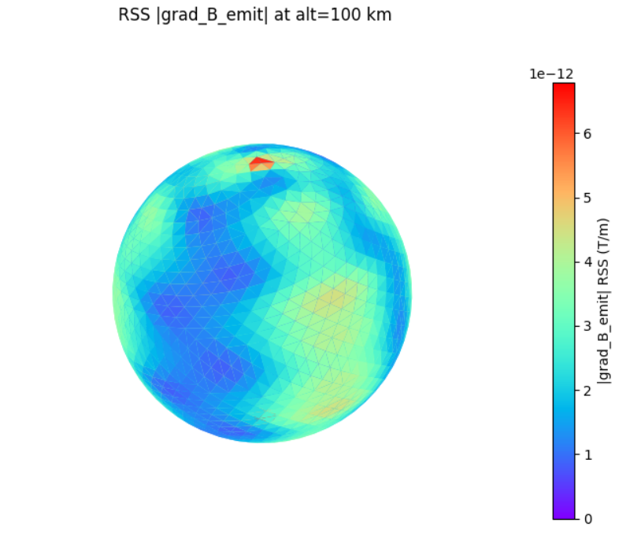
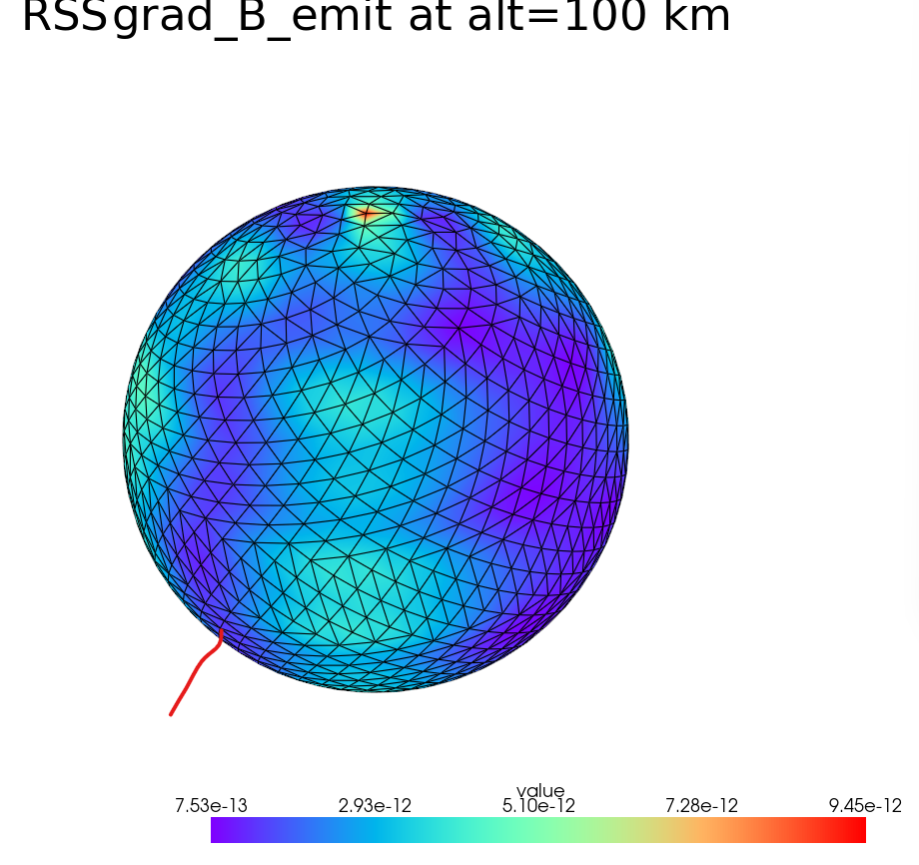
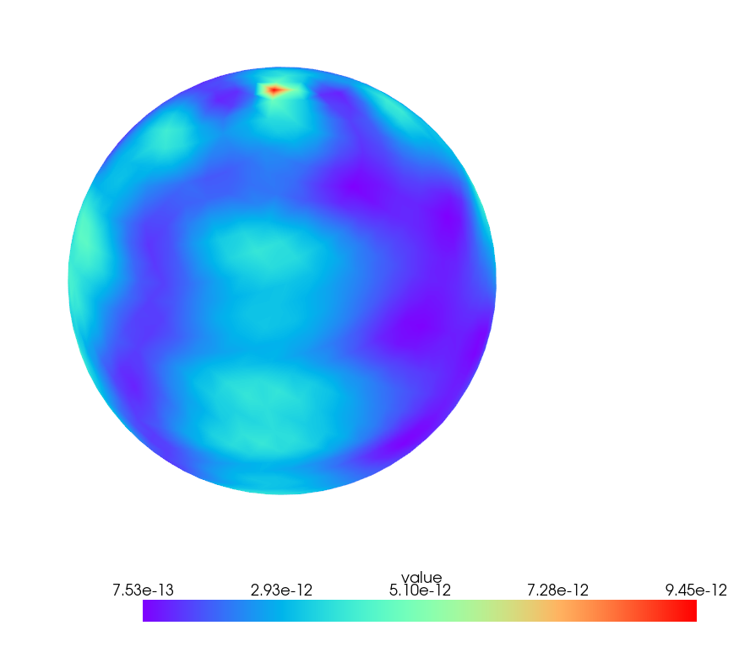
5% conductivity, no extra inductance
Matplot lib vs pylanc
Matplot lib
Py vista has interpolation but is less clear choose
matplotlib as the default
Few pT/m
Pyvista

Slide 8
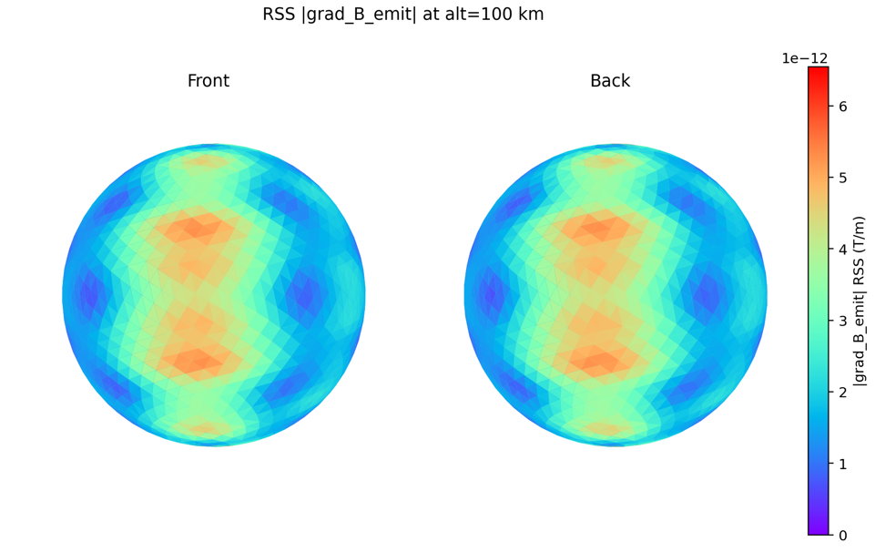
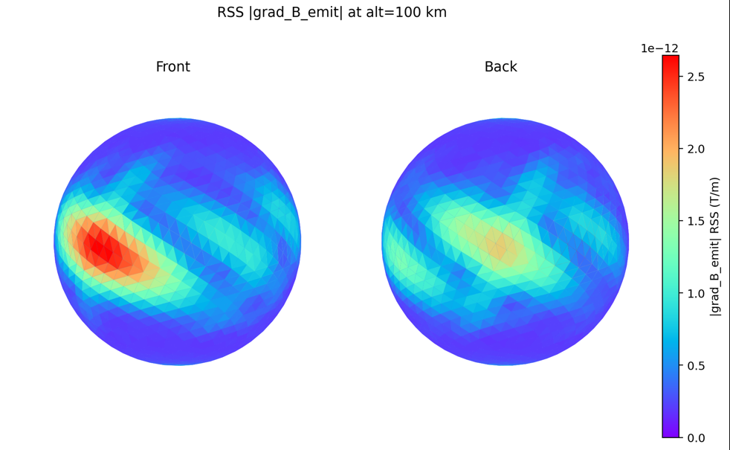
Effect of Inductance on Gradient
No Inductance
5% surface variation
Extra Inductance scale gradient by factor for
Why is inductance solution not 180 degree rotationally symmetry
  the ambient driver i a +X‑directed dipole pattern
Would be interesting to add mag field lines at the peak of the cycle
Error: Self consistent Solution Contains the back action , which is the inductance!
With Inductance

Slide 9
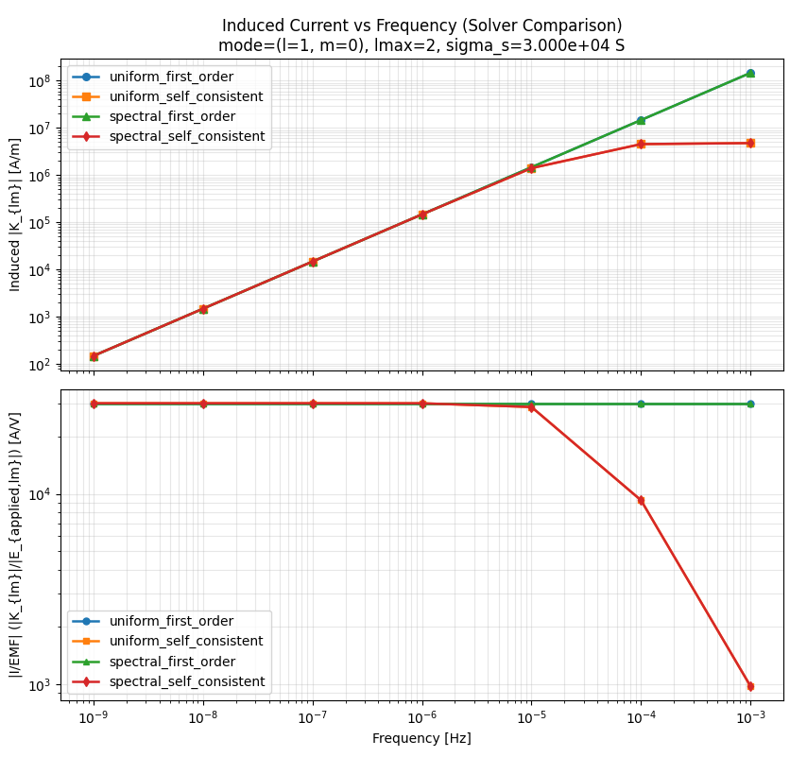
Self consistent solver includes inductance
See inductance rool off in self consistent models,
Not in first order models.
Only checked unform case in spectral solver but should be OK for if worked for uniform
Matched uniform solver
Could go back an check another mode of conductivity

Slide 10
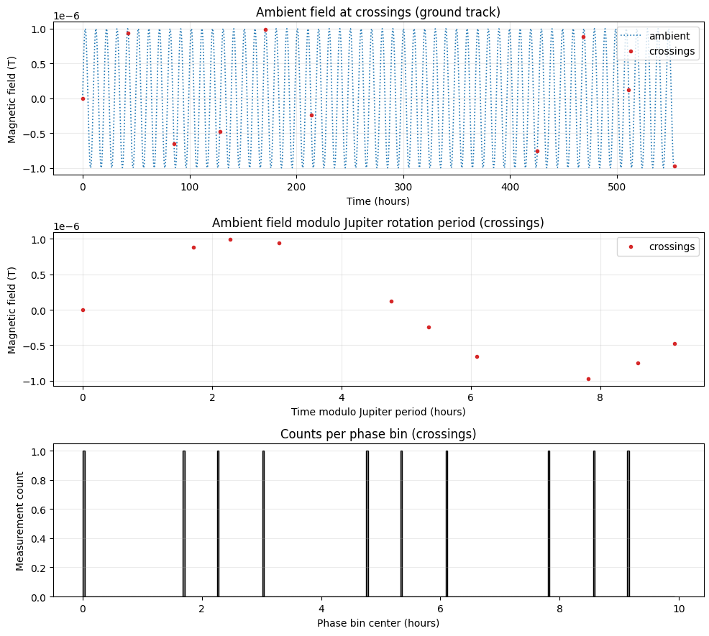
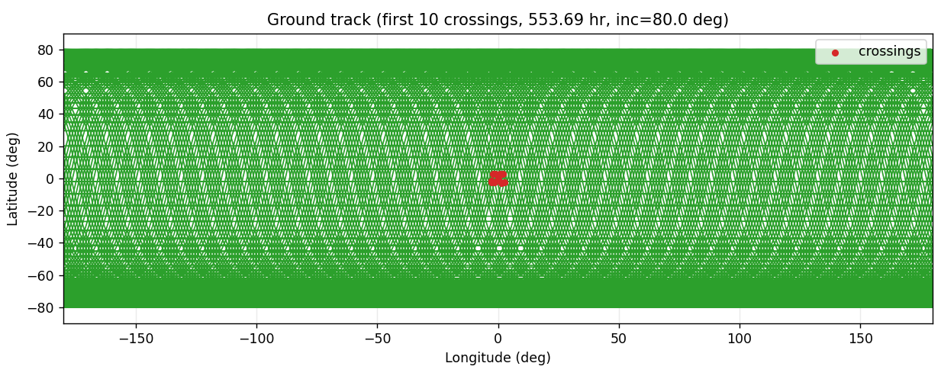
Orbital Considerations
Average crossing interval: 61.521 hours (221476.7 s)
Europa polar circular orbit (100 km altitude)
omega = 8.368765e-04 rad/s
speed = 1389.215 m/s
period = 2.086 hours
node mean spacing = 159.042 km
node transit time = 114.483 s
Europa rotation omega = 2.047827e-05 rad/s
Europa rotation during orbit = 1.537488e-01 rad
node angle (equator) = 9.580832e-02 rad
node drift per orbit = 1.605 nodes
field period (Jupiter rotation) = 9.925 hours
phase coverage gap = 110.480 s
phase coverage time = 821.698 hours
phase coverage orbits = 394
phase bin mean = 0.032
phase bin std = 0.176

Slide 11
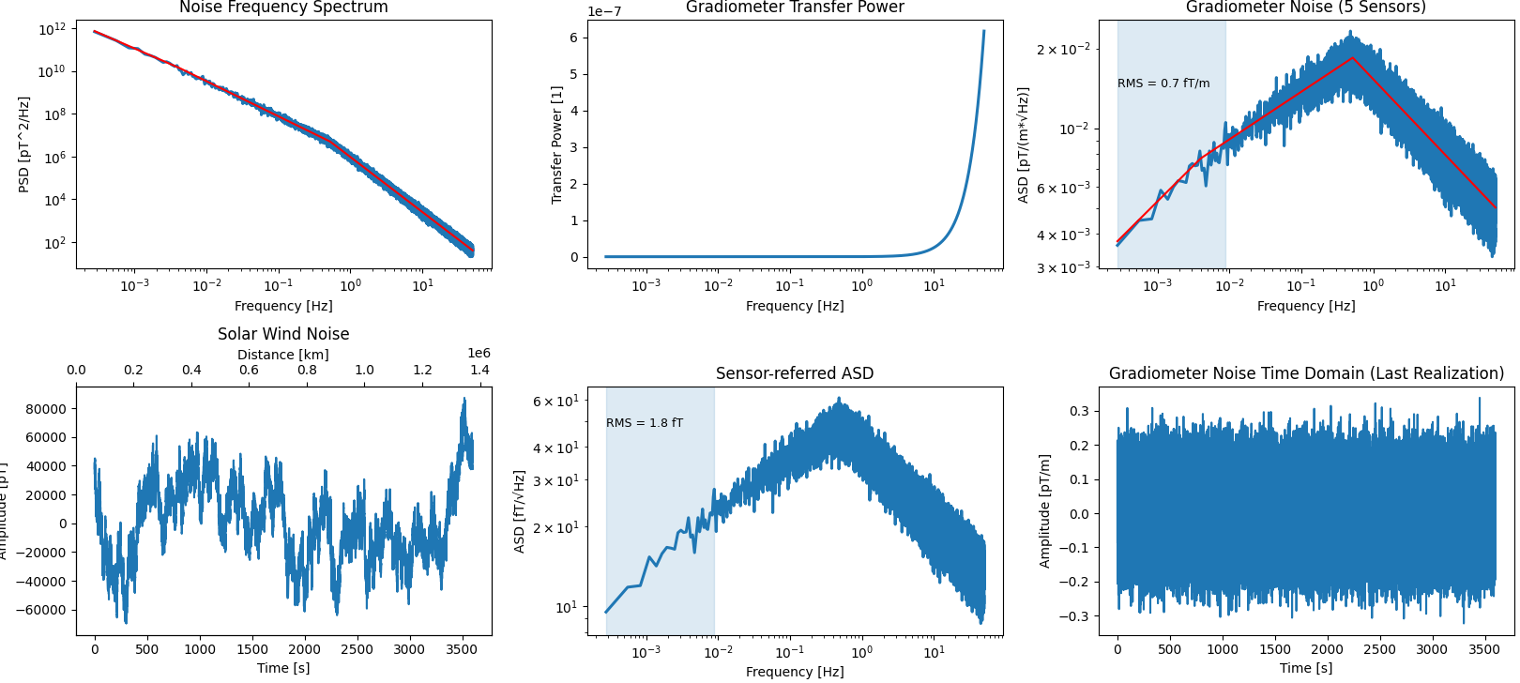
Solar Wind Noise RMS of 10 m boom
For 10m, 100km gradiometers Correlations time is well under a second
Node transit time: 114.483 s
RMS frequency range: 0 to 8.734921e-03 Hz
RMS noise: 0.7 fT/m
ASD = Amplitude Spectral Density
Would need 30 fT noise to match solar wind reduction
However , Gradients from 5% changes in conductivity are at the are at pT/m level > 1000 times the solar wind noise
So we could get 100s of fT and still measure

Slide 12
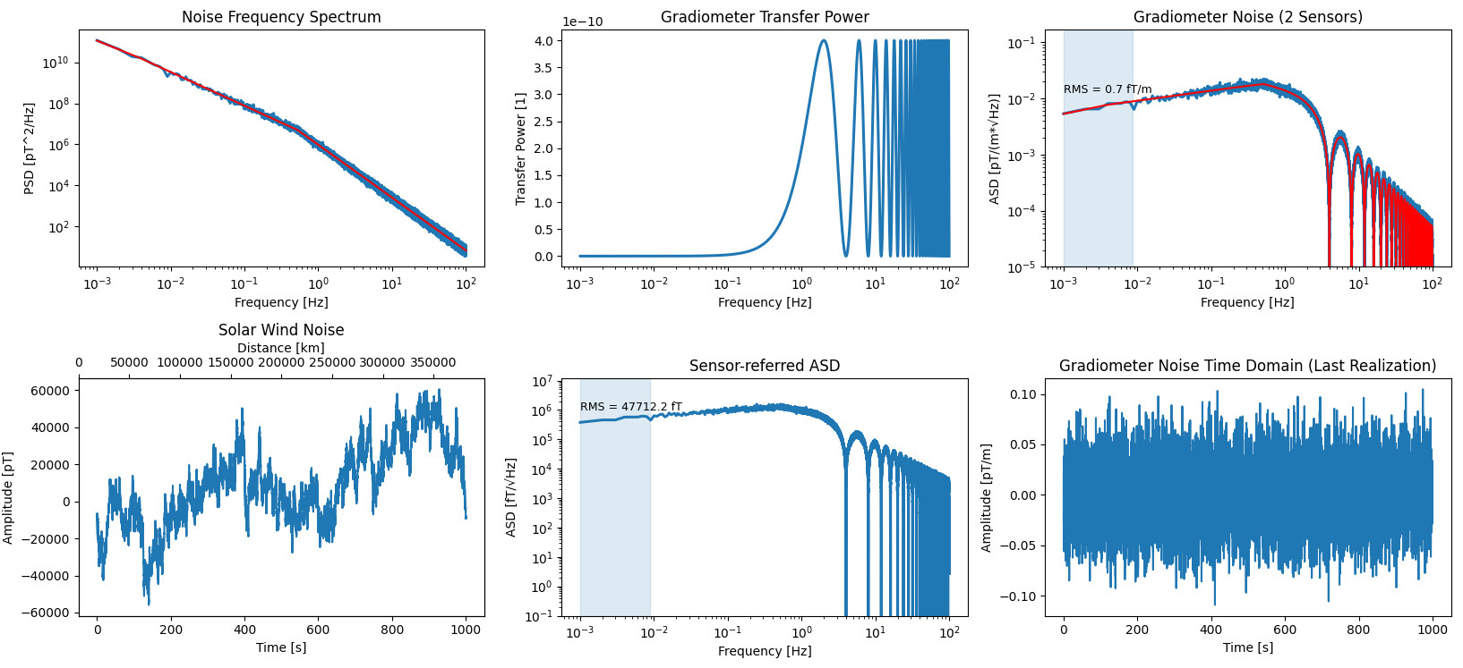
Solar Wind Noise RMS of 100 km Gradometer
Node transit time: 114.483 s
RMS frequency range: 0 to 8.734921e-03 Hz
RMS noise: 0.7 fT/m

